Slide 1
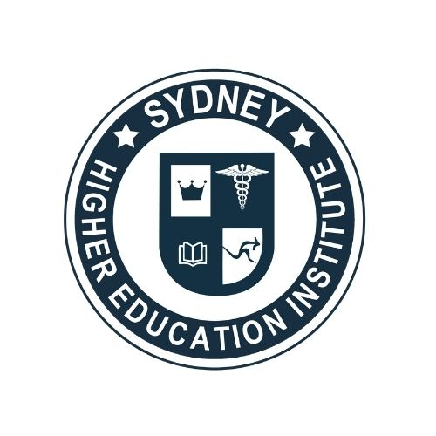
Sydney Higher Education Institute
Certificate IV in Tesol

Slide 2
ABOUT US
Sydney Higher Education Institute, a dynamic College headquartered in Sydney, Australia, provides a unique opportunity for participation in a variety of learning programs, which aim to address the needs of professionals and students in different fields.
Our vision is to be the most successful, prestigious and respected Accredited Further Education and Training College in the region and I take great pride in the quality of our lecturers and expert staff, who are sourced from Australasia and internationally as recognised leaders in their field.

Slide 3


Slide 4
Guide to Certificate IV TESOL Course Sydney
The task of teaching English to non-English speaking students is, of course, a tough one. But such tasks remain a vital element of the education system of Australia.
In this light, taking up a Certificate IV TESOL course Sydney assumes much importance.
In sum, if one thinks that TESOL qualification will enhance and add value to one’s career, one must not delay in applying for the same. The good news is that there are several institutions offering training for the TESOL course in Sydney.

Slide 5
Benefits Of The Course
TESOL courses endow one with many benefits. Here are some of the most apparent ones:
Short term commitment
Modules of practical assessment
The straightforward process of application
Affordability
The complete course typically takes only one year of study (comprising of 2 semesters). But this depends on the institution that one attends and their structure, of course. Take care to read their course content thoroughly and note the stipulations one requires to pass.

Slide 6


Slide 7

CONTACT US
Level 6 187 Macquarie St
Sydney, NSW 2000, Australia
Phone: 1300 794 683
admin@sydneyinstitute.org
https://tesol.sydney/

Slide 8


